Slide 1

Fast Food Analysis
Analyzing Fast Food restaurants against health data and population demographics in California counties
By: The Git Pandas
Dominica Corless, Jeremy Steele,
Jeremy Jang, Stanley Tan & Kelsey Cox

Slide 2
Objective:
*Edit
The intent of this project is to find correlations between Fast Food restaurants, California County demographics and Health issues.
Questions we intend to answer:
Is there any link between Fast Food restaurant population and obesity in the area?
Are Fast Food restaurants more common in lower income areas?
What is the concentration of Fast Food restaurants in the selected county? How high is the concentration of these health factors in our population areas?
We will be analyzing Census data for populations and demographics from the California Census, Fast Food data from the US Department of Agriculture, and Health data from the CDC.

Slide 3
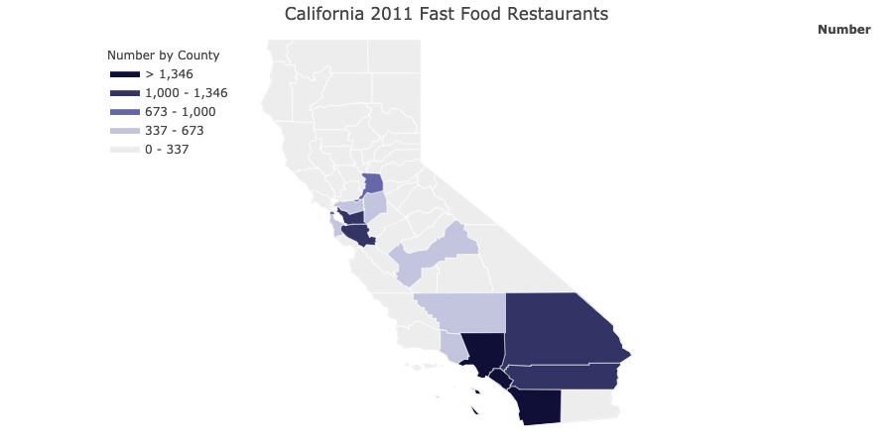
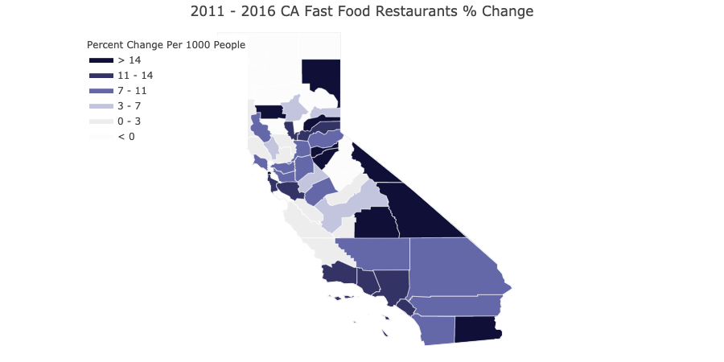

Fast Food Restaurants Per County in California
*A visible concentration in Southern CA.
Majority of counties experienced a very large percent change here. Due to Population increase?*

Slide 4
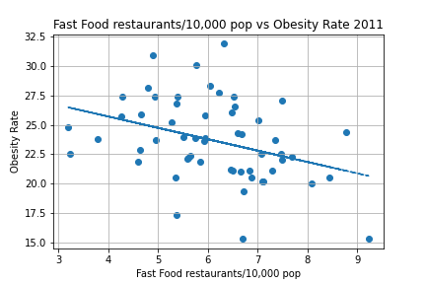
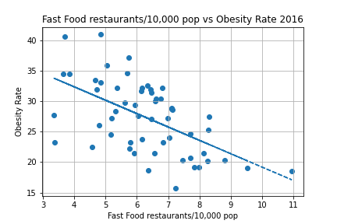
Obesity
Is there a correlation with obesity rates?
R value: -0.3588707718009065
R-squared value: 0.1287882308529783
R value: -0.5707195340440635
R-squared value: 0.32572078653947295

Slide 5
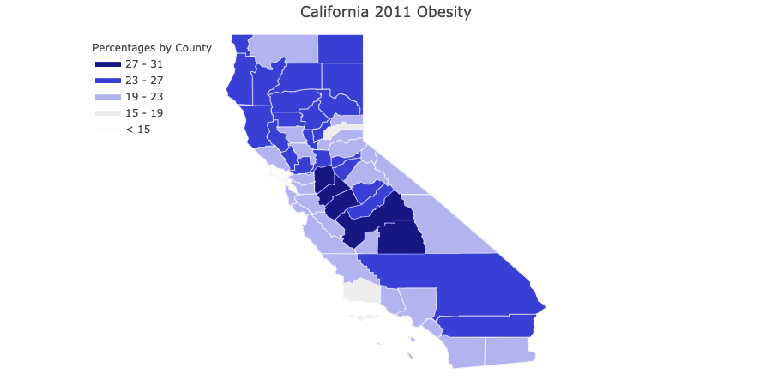
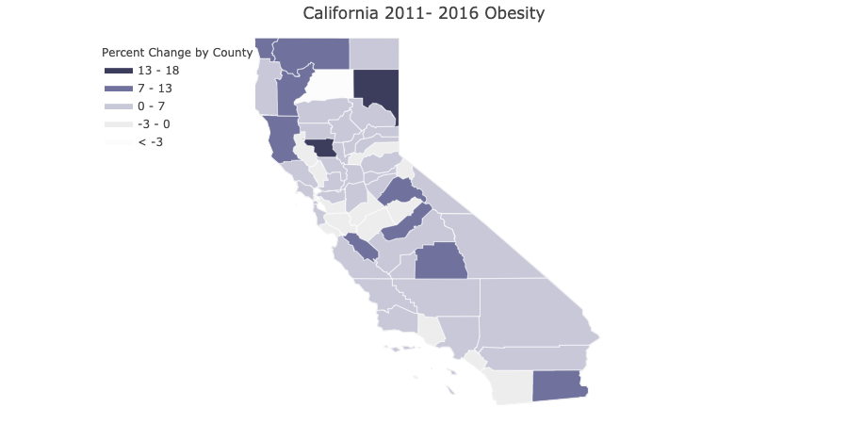
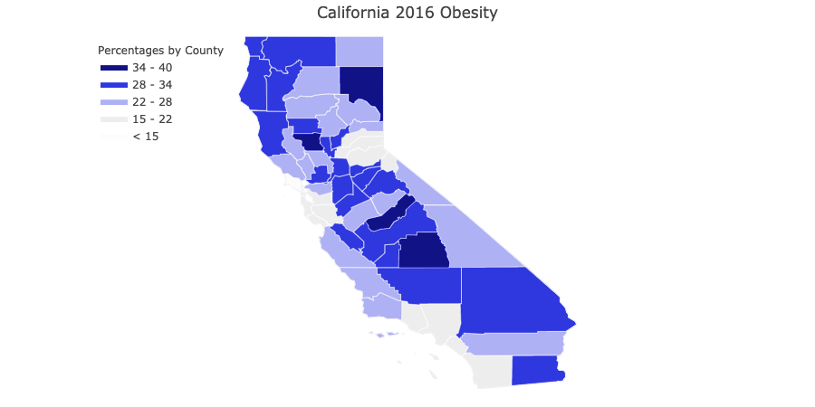

Obesity Rate by county
areas in CA most plagued by obesity

Slide 6
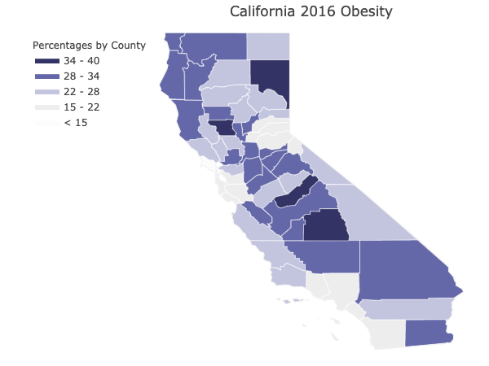
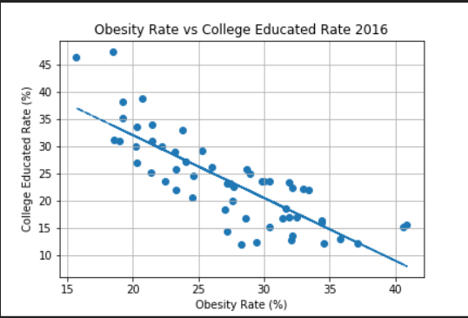
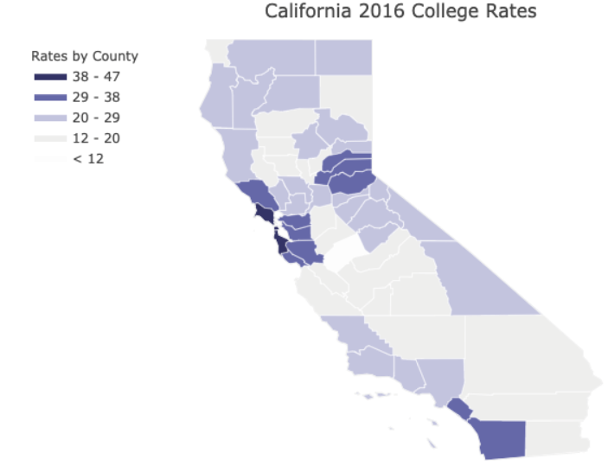
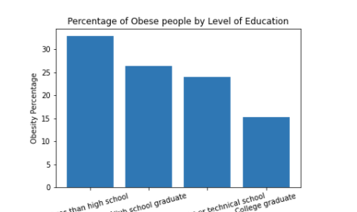
Diving
Deeper….
Is there a correlation between obesity and higher education? Are educated people more likely to be more health conscious?
R value: -0.8120860848378118 R-squared value: 0.6594838091872056
*Did not use College Rate 2012, College Rate change 2012-2016, would we prefer to use bar chart for obesity vs college 2016 here?

Slide 7
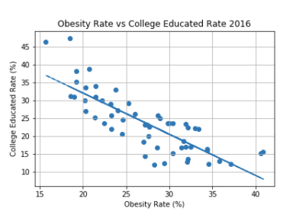
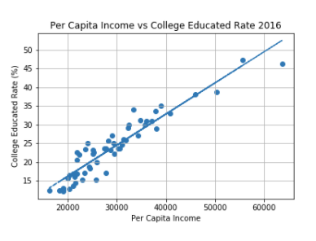
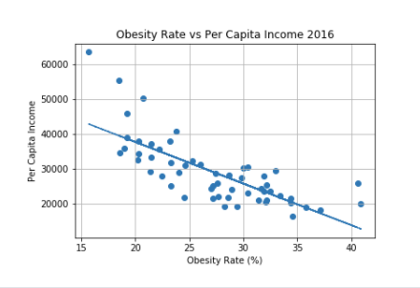
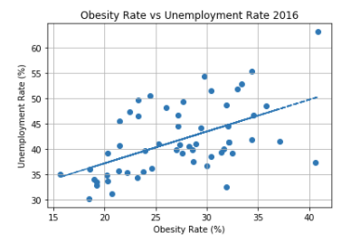
Obesity & Income
The strong negative correlations between obesity & college and obesity & income show a relationship between obesity and income.
*College education usually leads to a higher income and a higher income may yield access to healthier food options.
The strong positive correlations between education & income and obesity & unemployment show that a higher income and employment is a determinant to better health and food options.
R value: -0.8120860848378118
R-squared value: 0.6594838091872056
R value: 0.9404077031123526
R-squared value: 0.8843666480730507
R value: -0.7532467718723405
R-squared value: 0.5673806993361017
R value: 0.5316690237368231
R-squared value: 0.2826719508012666

Slide 8

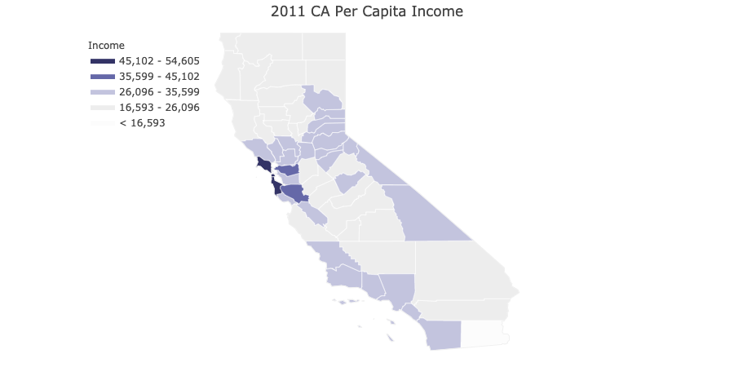
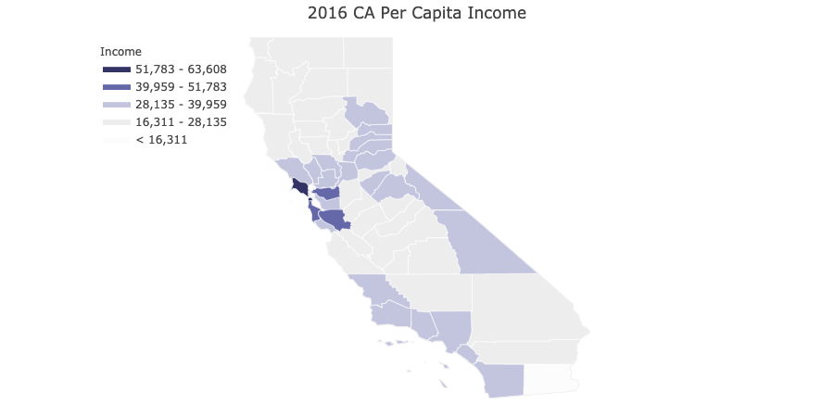
California Per Capita Income (PCI)
PCI is highest in Bay Area, LA and San Diego areas

Slide 9
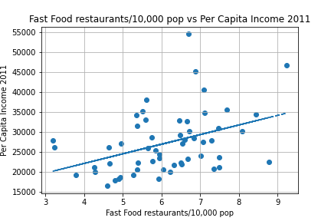
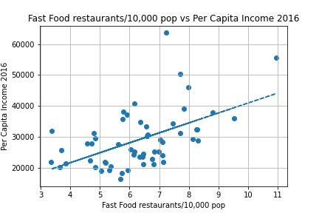
FAST Food Restaurants vs Income Per Capita
R value: 0.397767101106243
R-squared value: 0.15821866672246415
Correlation between more restaurants in counties with higher PCIs
R value: 0.5266912680213057
R-squared value: 0.2774036918098909

Slide 10
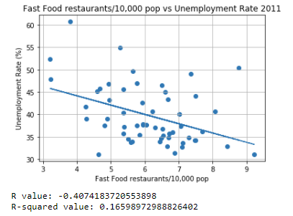
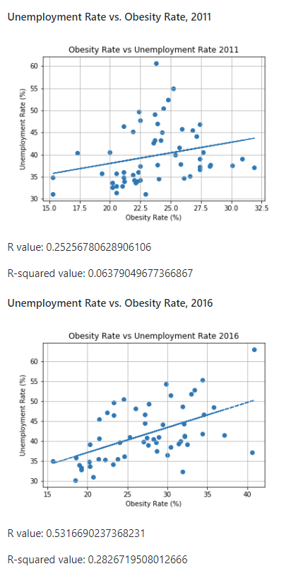
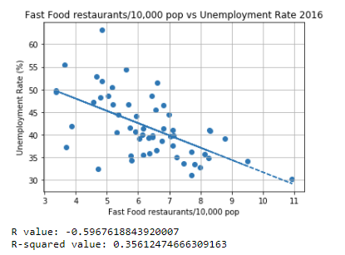
Fast Food Restaurants vs Unemployment Rate
There is a slight positive correlation between obesity & unemployment rates. This supports the relationship between higher incomes and lower obesity rates. We can infer if you are unemployed you are more likely to suffer from obesity.

Slide 11

A couple things we’ve noticed so far…
*Edit
We notice that obesity rates are far lower in coastal counties that feature a higher incomes per capita. These counties also feature the highest rates for college education and higher incomes. The strong correlations between obesity & employment and higher incomes show a relationship where higher incomes may lead to access to healthier food options that may lower risk of obesity.
*We can include the visuals if we go with this analysis… I know some of you guys want to avoid this, but its one of our stronger correlations.
We will not be analyzing fast food population versus total populations of California counties…

Slide 12

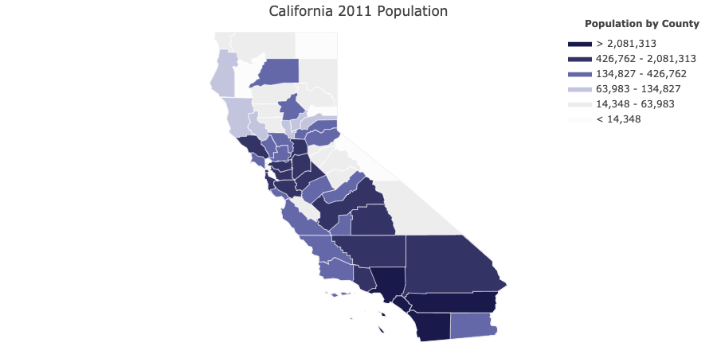
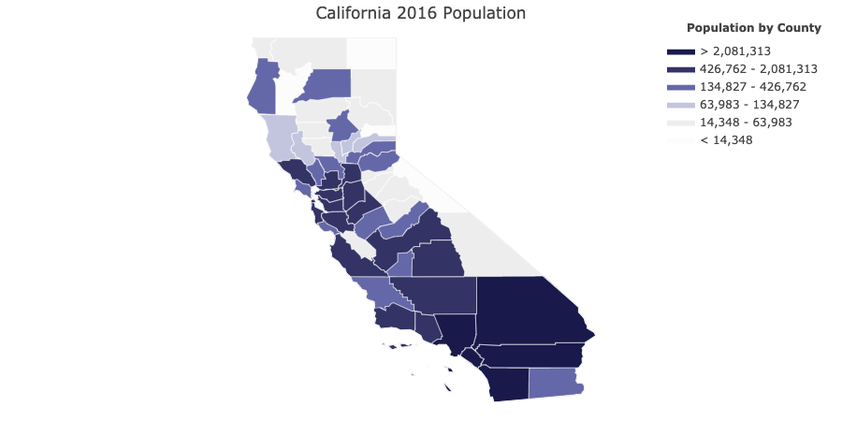
California Populations by County

Slide 13
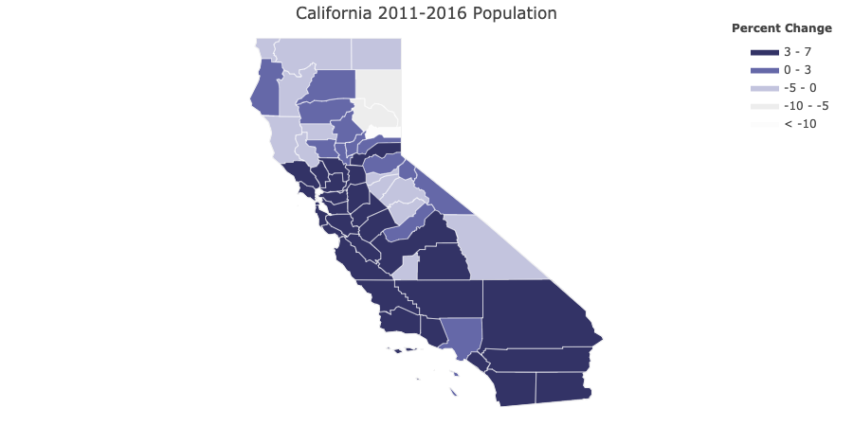
Population Change
Majority of California counties experienced a 3-7% change between the years 2011 to 2016.

Slide 14
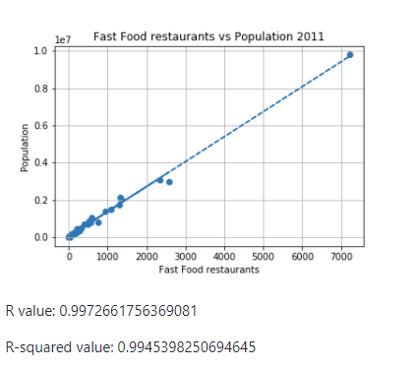
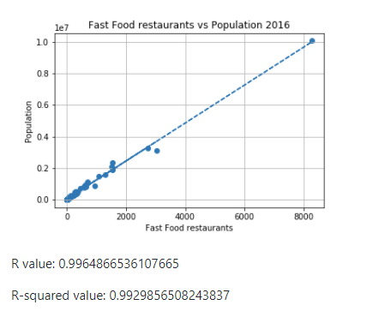
Fast Food Restaurants compared to population
We can see a there is a strong positive correlation of more fast foods restaurants in areas of higher population.
Supply and demand?

Slide 15
Conclusions
2011
2016
Final conclusions will be added after we discuss
Final conclusions will be added after we discuss

Slide 16
Data Sources:
Fast Food Data: [United States Department of Agriculture](https://www.ers.usda.gov/data-products/food-environment-atlas/go-to-the-atlas/).
California Census Data came from the Census API:
[Census Package](https://github.com/datamade/census).
Health Data: [CDC](https://gis.cdc.gov/grasp/diabetes/DiabetesAtlas.html).
* Revised and collected data we then used to draw conclusions can be found in:
* [All combined data on Census, Fast Food Restaurants, and Health](Analysis/data/census_health_ff_education.csv)
* [California Census Data 2011](Analysis/data/census_data_2011.csv)
* [California Census Data 2016](Analysis/data/census_data_2016.csv)
* [Fast Food and Health Data by County 2011 and 2016](Analysis/data/big_df.csv)
* [Fast Food Restaurants by County](Analysis/data/fast_food_combined_data.csv)
* [California County Population 2011 and 2016](Analysis/data/county_2011_2016.csv)

Slide 17
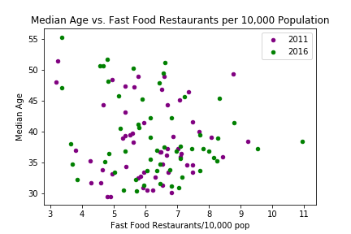
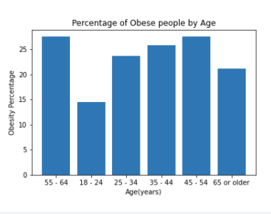
*Including this on here for now. Will update if we keep.
Median AGES per county and obesity rates.
Keep or DUMP?

Slide 18
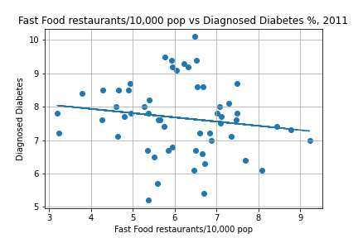
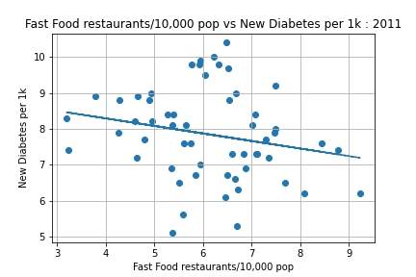
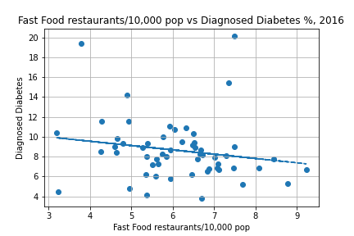
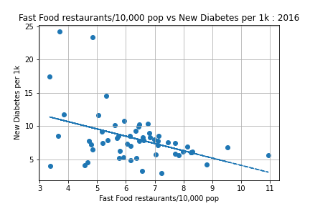
Diabetes Data
Which are we keeping? Feel like we could possibly forego this data from the presentation. No strong correlation present.
R value: -0.15058799370788611
R-squared value: 0.022676743848966348
R value: -0.1791024539510132
R-squared value: 0.03207768901127481
R value: -0.21390288619638717
R-squared value: 0.04575444472314456
R value: -0.4192249412583733
R-squared value: 0.17574955137308654

Slide 19
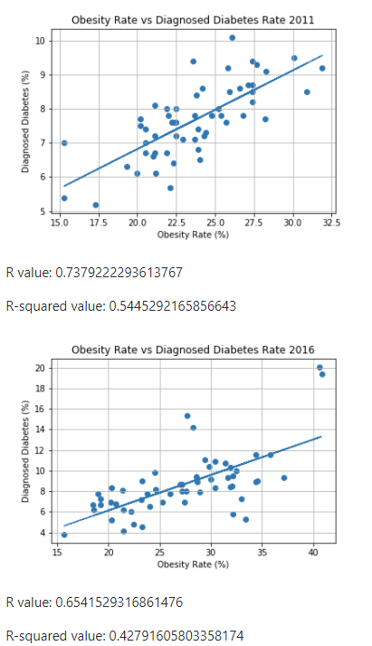
Could also include this for Diabetes… And other comparison charts. Going in the order suggested 10/4.
I think presentation would be less cluttered focusing solely on obesity- & other factors contribute to Diabetes, ie Type 1 v Type 2
Will update if we keep.

